Slide 1
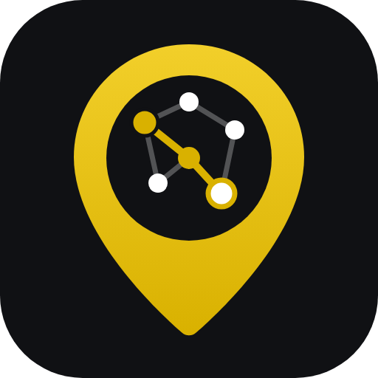


DSA LABORATORY PROJECT · DEPARTMENT OF CSE, KUET
CholoKUET
CHOLO EXPLORE KORE ASHI
An offline KUET campus navigator built on hand-written stacks, queues, trees and graphs. Also online at ettisafxrup.github.io/CholoKUET
Ettisaf Rup
Undergraduate, CSE, KUET
Roll 2407109
Afia Anjum Broti
Undergraduate, CSE, KUET
Roll 2407096
Course teachers Subah Nawar, Lecturer · Lamisa Bintee Mizan Deya, Lecturer · Data Structures and Algorithms Laboratory
Notes:
Hello everyone. We are Ettisaf and Afia, and our project is CholoKUET, a campus navigator for KUET. "Cholo explore kore ashi" means "come on, let's go explore". It runs offline in the terminal, and there is also an online version you can open in any browser. Every feature you will see today runs on a data structure from this course, and the stack and queue are written by hand.

Slide 2



THE PROBLEM
117 acres, 40-plus buildings, and nothing that tells you the way
Where is it?
How do I get there?
What's near me?
Buildings go by short forms: ACA, ME, Kodom Tola. New students and visitors can't tell which is which.
The obvious-looking walk is often not the real one. From the gate to the library you go past the halls.
Standing somewhere on campus, nothing tells you which hall, bank or canteen is closest.
We wanted one small program that answers all three, using only what we learned in this course.
CholoKUET · 02
Notes:
Every new batch spends its first weeks asking the same three questions: where is a building, how do I walk there, and what's near me. KUET buildings go by short forms, and the obvious-looking route is often not the real one. We wanted a small program that answers all three.

Slide 3


CHOLOKUET AT A GLANCE
Say where you are and where to go. Get the way.
44
56
15
907
places on campus
walkways
named roads
unit checks passing
The terminal app
The online version
C++17, one portable CholoKUET.exe with its own icon. Works fully offline, with student and admin accounts.
ettisafxrup.github.io/CholoKUET: the same campus data with BFS and DFS running live in the browser, plus the full report.
CholoKUET · 03
Notes:
In one line: say where you are and where you're going, and CholoKUET gives you the way. The campus has 44 places joined by 56 walkways on 15 roads, and 907 unit checks cover the code. You can use it two ways: the terminal app, which is one portable exe that works offline, and the online version on GitHub Pages, which runs the same campus data in the browser.

Slide 4











FEATURES
Everything CholoKUET does
Take me somewhere
What's near me
Explore the campus
Search
Turn-by-turn walking directions
10 closest places, distance and direction
Walk it all, check it's connected
Name, category or number
BFS · Queue · Stack
Haversine · bubble sort
DFS · Stack
Linear · binary search
Browse by category
Sort places
Where am I?
Trip history
KUET → category → place
A–Z, Z–A, category, distance
Set location by place or coordinates
Everywhere you've been, with Back
General tree
Bubble · selection
Haversine
Stack
Recent searches
Favorites
Admin tools
Online version
The last 10, newest first
Starred places, saved per user
Edit places, walkways, users, log
Live BFS/DFS demo in the browser
Linked list
Linked list
Array · Graph · Tree
GitHub Pages
CholoKUET · 04
Notes:
Here is everything in one place. Eleven menus for students: take me somewhere, what's near me, explore the campus, search, browse by category, sort, where am I, trip history, recent searches, favorites and help. Four more for admins. And the online version. Under each feature is the data structure or algorithm it runs on. The next slides go through them one group at a time.

Slide 5
FEATURE 1 · TAKE ME SOMEWHERE
Directions a person can actually follow
1
Type the start any way
Part of a name ("lib"), its number on the map, raw coordinates, or just Enter for where you are.
Central Library → KUET Main Gate
707 m walk · about 10 min · 9 places · 3 roads
DIRECTIONS
● Start at Central Library
1 Head south on Library Lane · 89 m
│ until you reach Fazlul Haque Hall
2 Turn left, heading east on Hall Road · 258 m
│ past Shaheed Smrity Hall, Rashid Hall
│ and Cafeteria, until you reach Kodom Tola
3 Turn left, heading east on KUET Road · 360 m
│ past KUET Dighi and Khan Jahan Ali Hall
● Arrive at KUET Main Gate
ROADS Library Lane → Hall Road → KUET Road
2
Directions by road
Consecutive walkways on one road merge into one step; compass bearings decide left, right or straight.
3
Every stop, with totals
A stops table with each leg and the running distance; walking time at 75 m a minute.
4
See the algorithm
"Show how BFS found this route" prints the queue and parent[] at every step.
5
"I'm going"
Pushes the trip onto the history stack, so Back can undo it.
CholoKUET · 05
Notes:
This is the main feature. You can type the start any way you like: part of a name, the number from the map, raw coordinates, or just press Enter to use where you are. BFS finds the route with the fewest stops, and then we turn it into directions: walkways on the same road merge into one step, and compass bearings decide left, right or straight. You also get every stop with running totals, and you can ask to see exactly how BFS found the route. Choosing I'm going pushes the trip onto the history stack.

Slide 6
FEATURES 2, 3, 7 · GETTING AROUND
Know what's around you, and see the whole campus
What's near me
Where am I?
Explore the campus
From a place or exact coordinates like 22.8992, 89.5016
Haversine distance to all 44 places
Bubble-sorted, nearest 10 shown with compass direction and walking time
Shows the comparison and swap counts
Pick a place, or type coordinates
Coordinates snap to the closest building (warns if over 2 km away)
Copy your coordinates to the clipboard for any map app
DFS from any place, optionally showing the stack at every step
Connectivity check: can every place be reached?
Every road with its walkways and total length
Haversine
Bubble sort
Linear scan
Haversine
DFS
Stack
CholoKUET · 06
Notes:
What's near me takes a place or exact coordinates, measures the Haversine distance to every place, bubble-sorts them and shows the nearest ten with a compass direction and walking time. Where am I sets your location, and coordinates snap to the closest building. Explore the campus runs DFS from any place, can show the stack at every step, checks that the campus is connected, and lists every road.

Slide 7
FEATURES 4, 5, 6 · FINDING PLACES
Search it, browse it, sort it
Search
Browse by category
Sort places
One box for everything. Exact names are found first with binary search on a sorted copy, then partial name and category matches with linear search.
The campus as a general tree: KUET at the root, 10 categories, 44 places as leaves. 55 nodes, height 3.
A–Z, Z–A, by category, or by distance from you. Prints how many comparisons and swaps each sort made.
› lib
binary search: 6 steps
1 Central Library
KUET
├── Academic 11 places
├── Residential 9 places
└── Landmark 4 places
by name, 44 places
bubble 367 swaps
selection 39 swaps
Linear
Binary search
General tree
Bubble
Selection sort
CholoKUET · 07
Notes:
Search is one box for names, categories and numbers. An exact name is found first with binary search on a sorted copy, then partial matches with linear search. Browse by category walks our general tree, KUET to category to place. Sort places sorts by name, category or distance, and prints the comparisons and swaps so you can compare bubble sort and selection sort.

Slide 8




FEATURES 8, 9, 10 · YOUR OWN TRAIL
It remembers where you've been
Trip history
Recent searches
Every place you go is pushed on a stack. Back pops the top and takes you to where you were before.
The last 10 places you opened, newest first. A repeat moves to the front instead of appearing twice.
Stack
Linked list
Favorites
Accounts
Star any place from its page. Saved per user in favorites.txt, so they are there next time you log in.
Log in or register as a student; admins get four more menus. Passwords are hidden while typing and stored hashed.
Linked list
FNV-1a hash
CholoKUET · 08
Notes:
CholoKUET remembers your trail. Trip history is a stack: every place you go is pushed, and Back pops the top. Recent searches is a linked list of the last ten, newest first. Favorites are saved per user, so they're still there next time. And accounts: students and admins, hidden password typing, and hashed passwords.

Slide 9




FEATURES 12–15 · ADMIN TOOLS, AND SMALL THINGS THAT MATTER
Built to be edited, and hard to break
ADMIN (MENUS 12–15)
EVERYWHERE IN THE APP
Type a place any way
name, part of a name, map number or coordinates
Manage places
Add, edit and delete. Deleting one also removes it from the graph, favorites, recent searches and the middle of the history stack.
Enter always goes back
no menu ever traps you
Never crashes on bad input
letters where numbers go just ask again
Manage walkways
Add or remove walkways with road names; the app warns if part of the campus becomes unreachable (DFS check).
Coloured in KUET gold
termcolor; plain text when piped or NO_COLOR is set
Saves as it goes
plain text files, readable in Notepad
Users and activity log
See every account (never passwords) and the timestamped log of logins, searches, routes and edits.
One portable .exe
static build with the CholoKUET icon
CholoKUET · 09
Notes:
Admins can add, edit and delete places and walkways. The important part is consistency: deleting a place removes it from the array, the graph, favorites, recent searches and even the middle of the history stack, by popping onto a second stack and pushing back. After a change the app runs DFS and warns if part of the campus is cut off. Everywhere in the app, you can type a place any way, Enter always goes back, bad input never crashes it, everything is saved as it happens, and it ships as one portable exe.

Slide 10
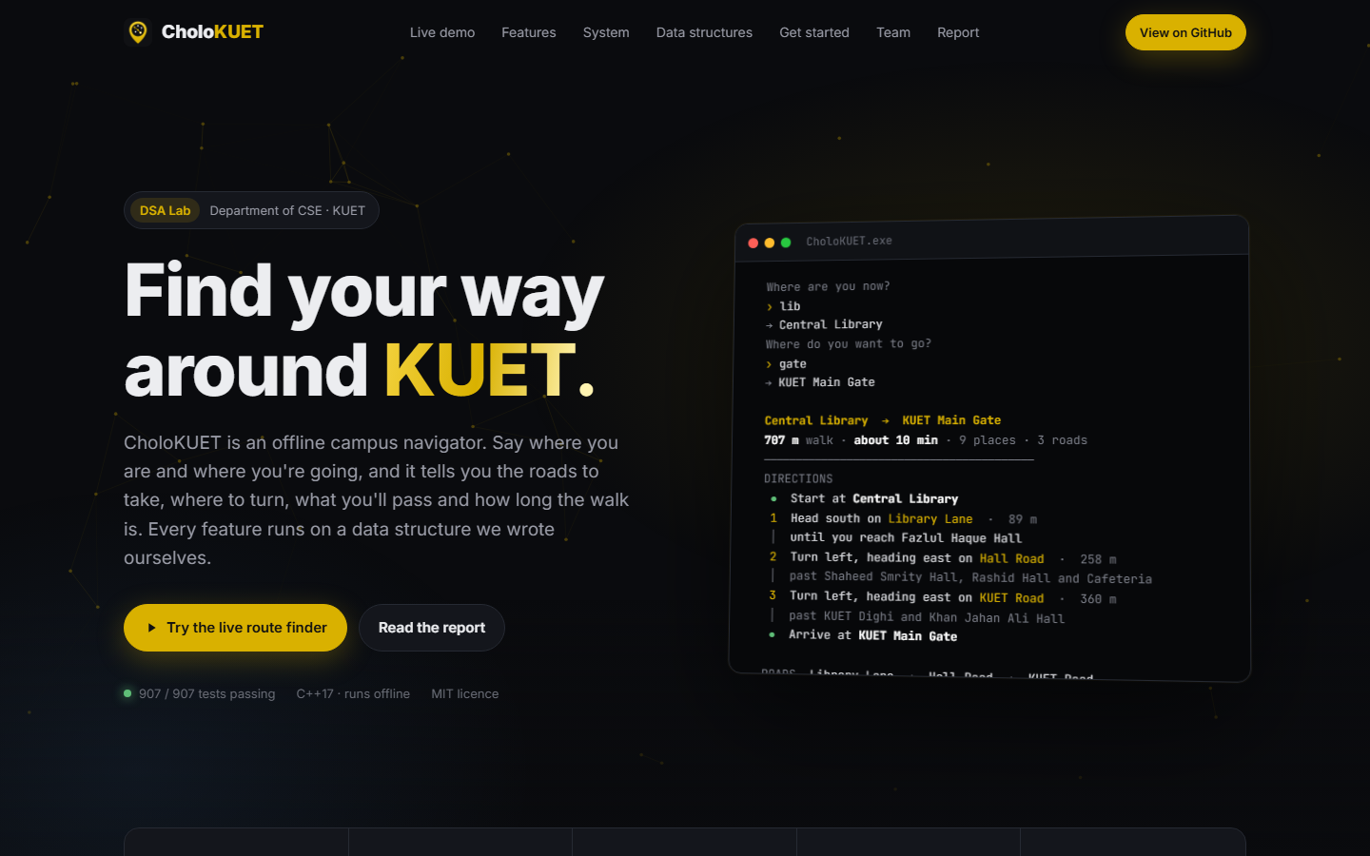




THE ONLINE VERSION
Open CholoKUET in any browser
ettisafxrup.github.io/CholoKUET
Live route finder
BFS and DFS on the real campus graph
Data structure playground
push, pop, enqueue, wrap around
Sort race
bubble vs selection, with live counts
The full report
readable and printable online
Nothing to install
hosted free on GitHub Pages
CholoKUET · 10
Notes:
Anyone can also use CholoKUET online, with nothing to install, at ettisafxrup.github.io/CholoKUET. It is hosted on GitHub Pages. It has a live route finder on the real campus graph, a playground for our stack and circular queue, a race between bubble sort and selection sort, and the full project report.

Slide 11
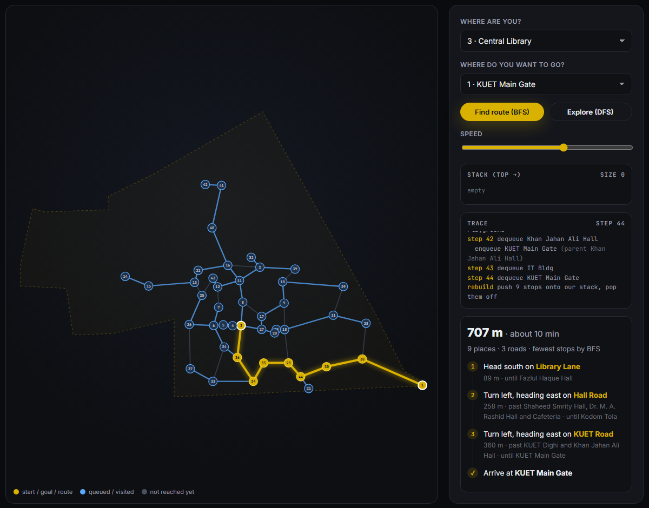
THE ONLINE VERSION · LIVE ROUTE FINDER
The same BFS, running in the browser
1
Real data
The 44 places and 56 walkways from data/, drawn at their true positions.
2
Pick or click
Choose two places from the lists or click them on the map.
3
Watch it work
The queue (BFS) or stack (DFS) fills and empties step by step, with a trace.
4
Same answer as the app
Library to Main Gate: 707 m, about 10 min, Library Lane → Hall Road → KUET Road.
CholoKUET · 11
Notes:
This is the live route finder. It uses the app's own data files. Pick two places, or click them, and you can watch BFS fill the queue ring by ring, or DFS work the stack. The gold line is the route. It follows the same rules as the C++ code, so it gives the same answer: 707 meters from the library to the main gate, on the same three roads.

Slide 12
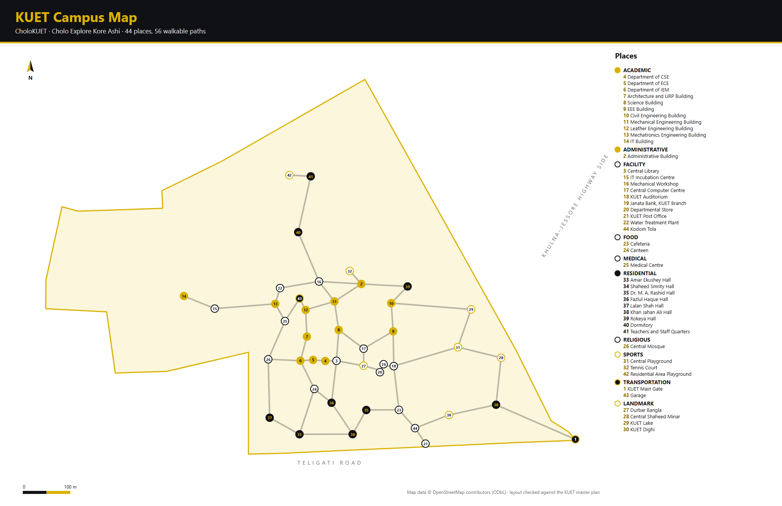
THE CAMPUS DATA
Real coordinates, not guesses
38 places use surveyed OpenStreetMap coordinates. The other 6 (including Kodom Tola) were measured off the KUET master plan, fitted to OSM with least squares on 18 shared buildings.
44
56
27 m
places
walkways
avg. fit error
CholoKUET · 12
Notes:
We started from the KUET master plan, but a drawing has no coordinates. OpenStreetMap had surveyed positions for most KUET buildings, so we used those. For the six buildings OSM doesn't have, including Kodom Tola, we matched 18 buildings between the plan and OSM and fitted a transform. It's off by 27 meters on average, about one building. The map is drawn from the app's own data files, and the numbers are the IDs you type in the app.

Slide 13
HOW IT'S ORGANISED
Three layers, each with one job
Navigator
Menus: login, trips, places, admin. Talks to the user only.
Why it matters
The stack can be opened and explained on its own (dsa/stack).
Each structure has its own test program.
The same core could sit under a graphical app, just as the online version reuses the data.
Campus
Places (array), categories and the walkway graph. The only code that touches files.
DSA core
Stack · Queue · Graph (BFS, DFS) · Tree · Search · Sort · Trip. No menus, no I/O.
data/*.txt
Plain text: locations, paths, categories, users, favorites. Plus logs/application.log.
CholoKUET · 13
Notes:
The menus never touch a file, and the data structures never print a menu. That's why you can open dsa/stack and see the stack on its own, why every structure has its own test, and why the same core could sit under a graphical app later.

Slide 14
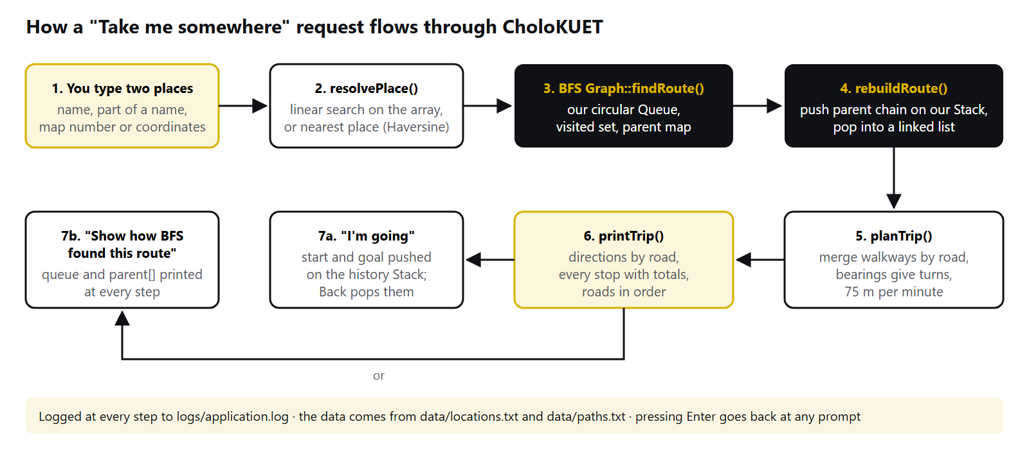
UNDER THE HOOD
How one trip request moves through the code
CholoKUET · 14
Notes:
This is one trip, end to end. The text you type goes to resolvePlace, which uses linear search or the nearest place by Haversine. BFS finds the route on our circular queue. rebuildRoute pushes the parent chain onto our stack and pops it into a linked list. planTrip merges walkways by road and works out the turns, and printTrip shows it. Then either I'm going pushes the trip onto the history stack, or you can watch the BFS trace.

Slide 15
WHERE EACH STRUCTURE LIVES
Every structure does real work
Structure | Built as | Used for
Stack | Hand-written array, top = -1 when empty | DFS, the Back button, reversing BFS routes
Queue | Hand-written circular array | BFS for every route
Array | std::vector<Location> | The list of all 44 places
Linked list | std::list<int> | Recent searches, favorites, BFS routes
Tree | General tree, children in a vector | Browse by category
Graph | Adjacency list with meters and road names | Walkways between places
Search, sort | Our own code, counting steps | Finding and ordering places
Highlighted rows are written from scratch. make check-manual proves std::stack, std::queue and std::sort are never used.
CholoKUET · 15
Notes:
The two highlighted rows are written from scratch, as the lab asked. The other containers come from the STL, but every algorithm running on them is ours. make check-manual scans the code and confirms there's no std::stack, std::queue or std::sort anywhere.

Slide 16
HAND-WRITTEN · DSA/STACK AND DSA/QUEUE
Last in, first out. First in, first out, and it wraps
bool Stack::push(int value)
{
if (isFull())
return false; // overflow
data[++top] = value;
return true;
}
bool Queue::enqueue(int value)
{
if (isFull()) return false;
rear = (rear + 1) % CAPACITY;
data[rear] = value;
count++; // tells full from empty
}
Central Library
← top: Back pops Central Library
900
901
·
·
40
50
60
70
Mechanical Eng. Building
Administrative Building
0
1
2
3
4
5
6
7
KUET Main Gate
rear wrapped round to slots 0 and 1; front is at slot 4
CholoKUET · 16
Notes:
The stack is an array plus one index, top. Push moves top up and writes, pop reads and moves it down, and both refuse instead of writing outside the array. Pressing Back in Trip history pops the top. The queue wraps around with modulo, so freed slots are reused: here the new values 900 and 901 went into slots 0 and 1. With only front and rear, full and empty look the same, so we keep a count.

Slide 17
GRAPH · BFS · DFS
Queue for the search, stack for the answer
1 · Explore
Dequeue a place, enqueue its unvisited neighbours, ring by ring (our Queue).
2 · Remember
parent[next] = current. Mark visited when queued, so nothing is queued twice.
3 · Rebuild
Walk parent[] back from the goal, push each stop, pop them in order (our Stack).
Library → Fazlul Haque Hall → Shaheed Smrity Hall → Rashid Hall → Cafeteria → Kodom Tola → KUET Dighi → Khan Jahan Ali Hall → Main Gate
9 stops · 707 m walking · 529 m straight line · O(V + E)
DFS, iterative on our stack.
The top is the place being explored; we remember how far we got through its neighbours. Each place is pushed once, so the 200-slot stack can never overflow. The first textbook version could, and a test on a complete 200-vertex graph now guards it.
CholoKUET · 17
Notes:
BFS explores outward one ring at a time using our queue. The key detail: we mark a place visited when we enqueue it, otherwise it can be queued twice. parent records how we reached each place, and to rebuild the route we push the parent chain onto our stack and pop it off. BFS minimises stops, not meters, so the app prints both distances. DFS is iterative on our stack and pushes each place once. Our first version didn't, and could overflow, which a test now guards against.

Slide 18
SEARCHING AND SORTING, ON OUR 44 PLACES
44 → 6
367 → 39
comparisons to find "Central Library": linear search vs binary search on sorted data
swaps to sort by name: bubble sort vs selection sort (946 comparisons, exactly 44 × 43 / 2)
Binary search is O(log n) but needs sorted data. Bubble sort is stable and stops early; selection sort makes at most n − 1 swaps. Both are O(n²).
CholoKUET · 18
Notes:
Two numbers from our own runs. Finding the library takes 44 comparisons with linear search and 6 with binary search, but binary search only works on sorted data, so the app sorts a copy first. Sorting by name, bubble sort made 367 swaps and selection sort only 39, though selection made more comparisons: 946, exactly 44 times 43 over 2.

Slide 19
TESTING
907 checks, 8 suites, all passing
Edge cases on purpose
Overflow at 200, underflow, queue wraparound, unreachable goals, a complete 200-vertex graph, duplicates and stability.
The whole app, scripted
Every menu as a student and an admin: wrong passwords, letters where numbers go, adding and deleting places. It never crashed, and no password reached the log.
make test
CholoKUET · 19
Notes:
Every module has its own test program, run with make test: 907 checks in total, all passing. They target the edge cases on purpose. On top of that we drove the whole app with scripted input as a student and as an admin. It never crashed, and the log never contains a password.

Slide 20
LIVE DEMO
What we'll show now
make run, log in as student1
5 Browse by category (tree)
1 Take me somewhere: lib → gate
4 Search "hall", 6 sort A–Z
Show how BFS found this route
Open Stack.cpp and Queue.cpp
2 What's near me, from coordinates
The online version: live BFS
8 Trip history: Back (stack)
The report online
3 Explore from Civil (DFS + stack)
Questions
Terminal: make run · student1 / student123 · Browser: ettisafxrup.github.io/CholoKUET
CholoKUET · 20
Notes:
Switch to the terminal now. Run make run and log in as student1. Menu 1: where are you, "lib"; where to, "gate". Read out the directions, then choose Show how BFS found this route, then I'm going. Menu 2 with coordinates 22.8992, 89.5016. Menu 8 and press Back. Menu 3, DFS from Civil with the stack shown. Menu 5 for the tree, menu 4 to search "hall", menu 6 to sort A to Z. Open dsa/stack/Stack.cpp and dsa/queue/Queue.cpp. Then switch to the browser and run the live route finder on the online version, and show the report page.

Slide 21
LIMITS AND NEXT STEPS
What it can't do yet, and what's next
Today
Next
BFS gives the fewest stops, not the fewest meters
Six positions are estimates, about 30 m
Buildings only, no rooms or floors
Typed coordinates, no live GPS
Demo-grade login (FNV-1a hash)
Dijkstra and A* next to BFS, for the shortest walk
Accessible routes: ramps, no stairs
Rooms and labs as a deeper tree level
Phone GPS snapped to the nearest building
A Bangla interface, and our missing buildings added to OSM
CholoKUET · 21
Notes:
We'd rather say these ourselves. BFS ignores walkway length, six buildings are estimated, and the login is for a demo only. The first thing we'd add is Dijkstra alongside BFS, so the app can show both the fewest-stops and the fewest-meters route.

Slide 22

Thank you. Questions?
Online ettisafxrup.github.io/CholoKUET
Code github.com/ettisafxrup/CholoKUET
Ettisaf Rup
CSE, KUET · Roll 2407109
Afia Anjum Broti
CSE, KUET · Roll 2407096
CholoKUET · 22
Notes:
Thank you for listening. We're happy to take questions, and we can open any file live: the stack, the queue, BFS or DFS, or try any route on the online version.

